Slide 1

Togo, Africa: On Track for over 3°C of Warming by 2100
Andrew Long, Jacob Englert
Northern Kentucky University

Slide 2
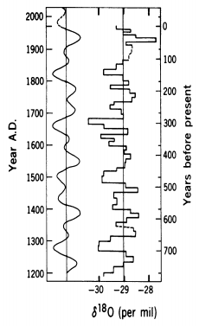
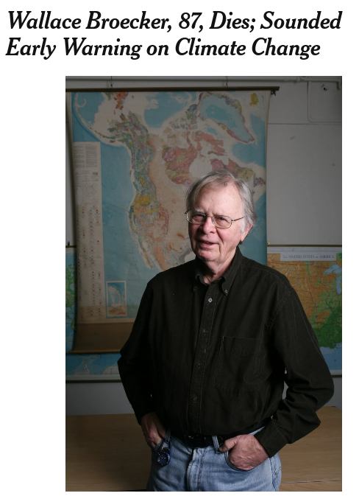
Dr. Wally Broecker died this year:
In 1975 he wrote a paper with a provocative title: Climatic Change: Are We on the Brink of a Pronounced Global Warming? – due to the end of a natural cooling cycle, and the rapid escalation of fossil fuel use worldwide.
Wally based his prediction on the curve at right, showing the superposition of an 80 year and180 year cycles on ice core data from Greenland (obtained “by power spectral techniques”).
(Oxygen isotope ratio is a proxy for temperature.)

Slide 3
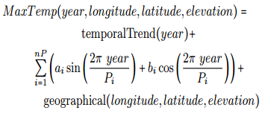
Togo Temperature Project Creation Story
At the start of my 2018 math modeling course, I told my students that my brother-in-law works in the Togolese Meteorological Service, and could get us historical temperature data from Togo.
I also said that I was pretty sure (like really, really sure) that the data would suggest increasing temperatures. Our job: study and model it: e.g.
Notes:
During the course, students engaged in mini-Projects:
First project – study yearly minimum and maximum temperatures
Second project – model monthly minimum and maximum
Third project – model rainfall (including max/min temperatures)
For a final project, three teams: data quality, modelling, research/writing

Slide 4
Togo Temperature Project Creation Story
At the start of my 2018 math modeling course, I told my students that my brother-in-law works in the Togolese Meteorological Service, and could get us historical temperature data from Togo.
I also said that I was pretty sure (like really, really sure) that the data would suggest increasing temperatures. Our job: study and model it: e.g.
Our focus: temporal trend, and periods (cycles), which we would hope to tie to climate cycles (e.g. El Nino).
Notes:
During the course, students engaged in mini-Projects:
First project – study yearly minimum and maximum temperatures
Second project – model monthly minimum and maximum
Third project – model rainfall (including max/min temperatures)
For a final project, three teams: data quality, modelling, research/writing

Slide 5
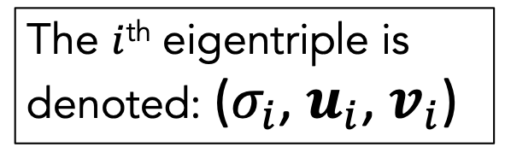
Singular Spectrum Analysis (SSA)
Period detection tool
Implemented with the RSSA package in R
Two steps:
Decomposition – SVD with a special matrix A
Reconstruction – Eigentriple grouping and diagonal averaging
The $i$^{th} eigentriple is denoted: ($σ_{i}$, $u_{i}$, $v_{i}$)

Slide 6

Case Study: Sokodé (Minima)
$$A=\left[\begin{matrix}T_{1/1961} & T_{2/1961} & … & T_{7/1988} \\ T_{2/1961} & T_{3/1961} & … & T_{8/1988} \\ T_{3/1961} & T_{4/1961} & … & T_{9/1988} \\ ⋮ & ⋮ & ⋱ & ⋮ \\ T_{6/1988} & T_{7/1988} & … & T_{12/2015}\end{matrix}\right]$$
Apply SVD
Group eigentriples with similar singular values
Average the grouped matrices to obtain the new time series

Slide 7
Case Study: Sokodé

Slide 8
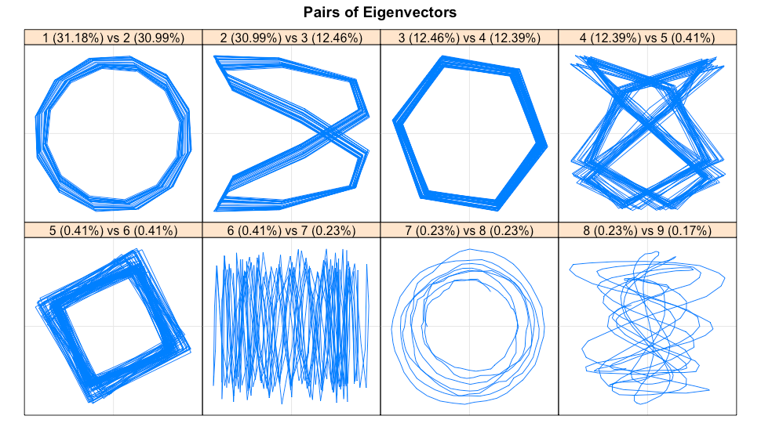
Period Detection in Detrended Sokodé Minima
Periods Detected:
12 month
6 month
4 month
~9 year (see Pacific Decadal Oscillation)

Slide 10
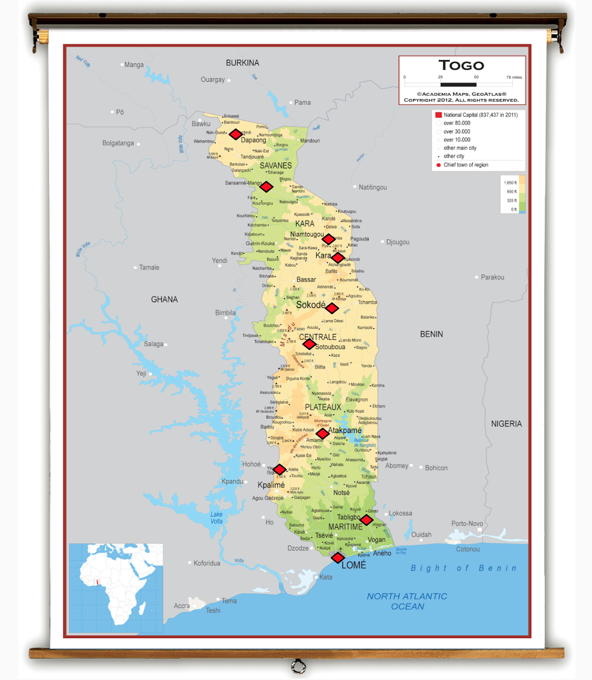
From North to South:
Dapaong
Mango
Niamtougou
Kara
Sokodé
Sotouboua
Atakpamé
Kouma-Konda
Tabligbo
Lomé
Notes:
The data was provided for the following ten cities. Ordered from North to South we have: Dapaong, Mango, Niamtougou, Kara, Sokodé, Sotouboua, Atakpamé, Kouma-Konda, Tabligbo and Lomé

Slide 11
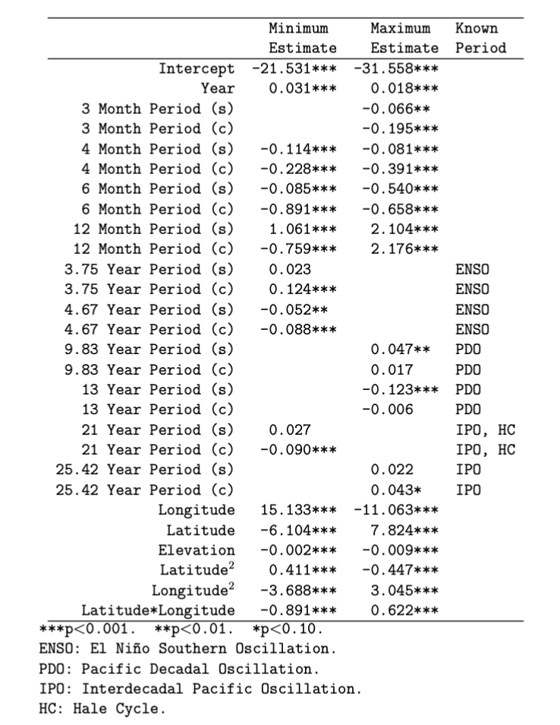
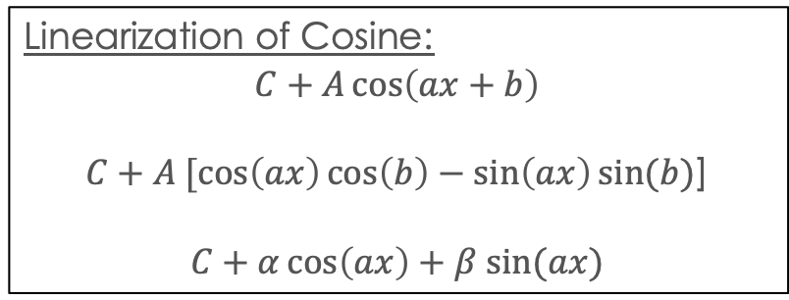
Summary of Modeling
SSA repeated 20x (10 cities x 2 temperature sets)
Periods detected implemented into a pair of global regression models
Linearization of Cosine:
$$C+A\cos\left(ax+b\right)$$
$C+A [\cos\left(ax\right)\cos\left(b\right)−\sin\left(ax\right)sin⁡(b)$]
$$C+α\cos\left(ax\right)+β sin⁡(ax)$$

Slide 12
Summary of Modeling
SSA repeated 20x (10 cities x 2 temperature sets)
Periods detected implemented into a pair of global regression models
Linearization of Cosine:
$$C+A\cos\left(ax+b\right)$$
$C+A [\cos\left(ax\right)\cos\left(b\right)−\sin\left(ax\right)sin⁡(b)$]
$$C+α\cos\left(ax\right)+β sin⁡(ax)$$

Slide 13
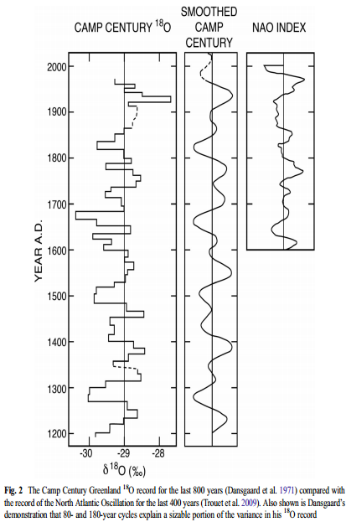
Wally Broecker, in 2017: “it was dumb luck...”
– “As other records including those for ice
cores from southern and central Greenland
appeared, none showed Dansgaard’s
180- and 80-year cycles.”
– “I place [the NAO index] side by side with Dansgaard’s Greenland ¹⁸O record and that for the NAO index. While by no means identical to the Dansgaard record, the NAO record has humps and valleys of similar duration.”

Slide 14
Wally Broecker, in 2017: “it was dumb luck...”
– “Vinther et al. (2003) had shown that the ¹⁸O record in Greenland ice resembled that for the NAO. If so, it certainly cannot be used, as I did, as a proxy for global temperature.”
Wally assumed that a pattern – an oscillatory pattern – in his data was a proxy for global temperature, and he extrapolated from that.
A cautionary tale!

Slide 15
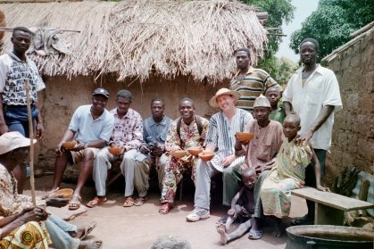
Thank you for your attention!
Questions or Comments?
Andy Long
longa@nku.edu
Jacob Englert
englertj1@nku.edu
Andy says:
“It’s gettin’ hot –
let’s have a drink!”

